Slide 1
NDT an Insurers View What we want and how we use it Paul Miller Director of Underwriting

Slide 2
ABOUT MILLSTREAM
The Underwriting Agency was purchased by Nexus Group in December 2020 and became part of their Millstream brand from 1st January 2021
Our product range includes Yachtsure24 (Superyachts), Yachtsure, Racecover and Marine Trades with the Raceocover product most related to this talk.
At the centre of our business are our underwriters; each with a proven track record and significant expertise in their respective fields. The MGA platform, which provides capacity, claims, regulatory, compliance and operational support allows them to concentrate on what they do best; getting out into the markets and building a profitable book of business.
Under our Racecover facility we insure both inshore and offshore racing yachts and aim at the difficult to place higher risk racing yachts that are participating in specific campaigns, regattas, transatlantic or global events. This is a tailored facility for racing yachts with no minimum value requirements.
We provide coverage for the physical damage, liability and war with extensions for loss of mast, spars and rigging, two handed or single handed sailing.

Slide 3
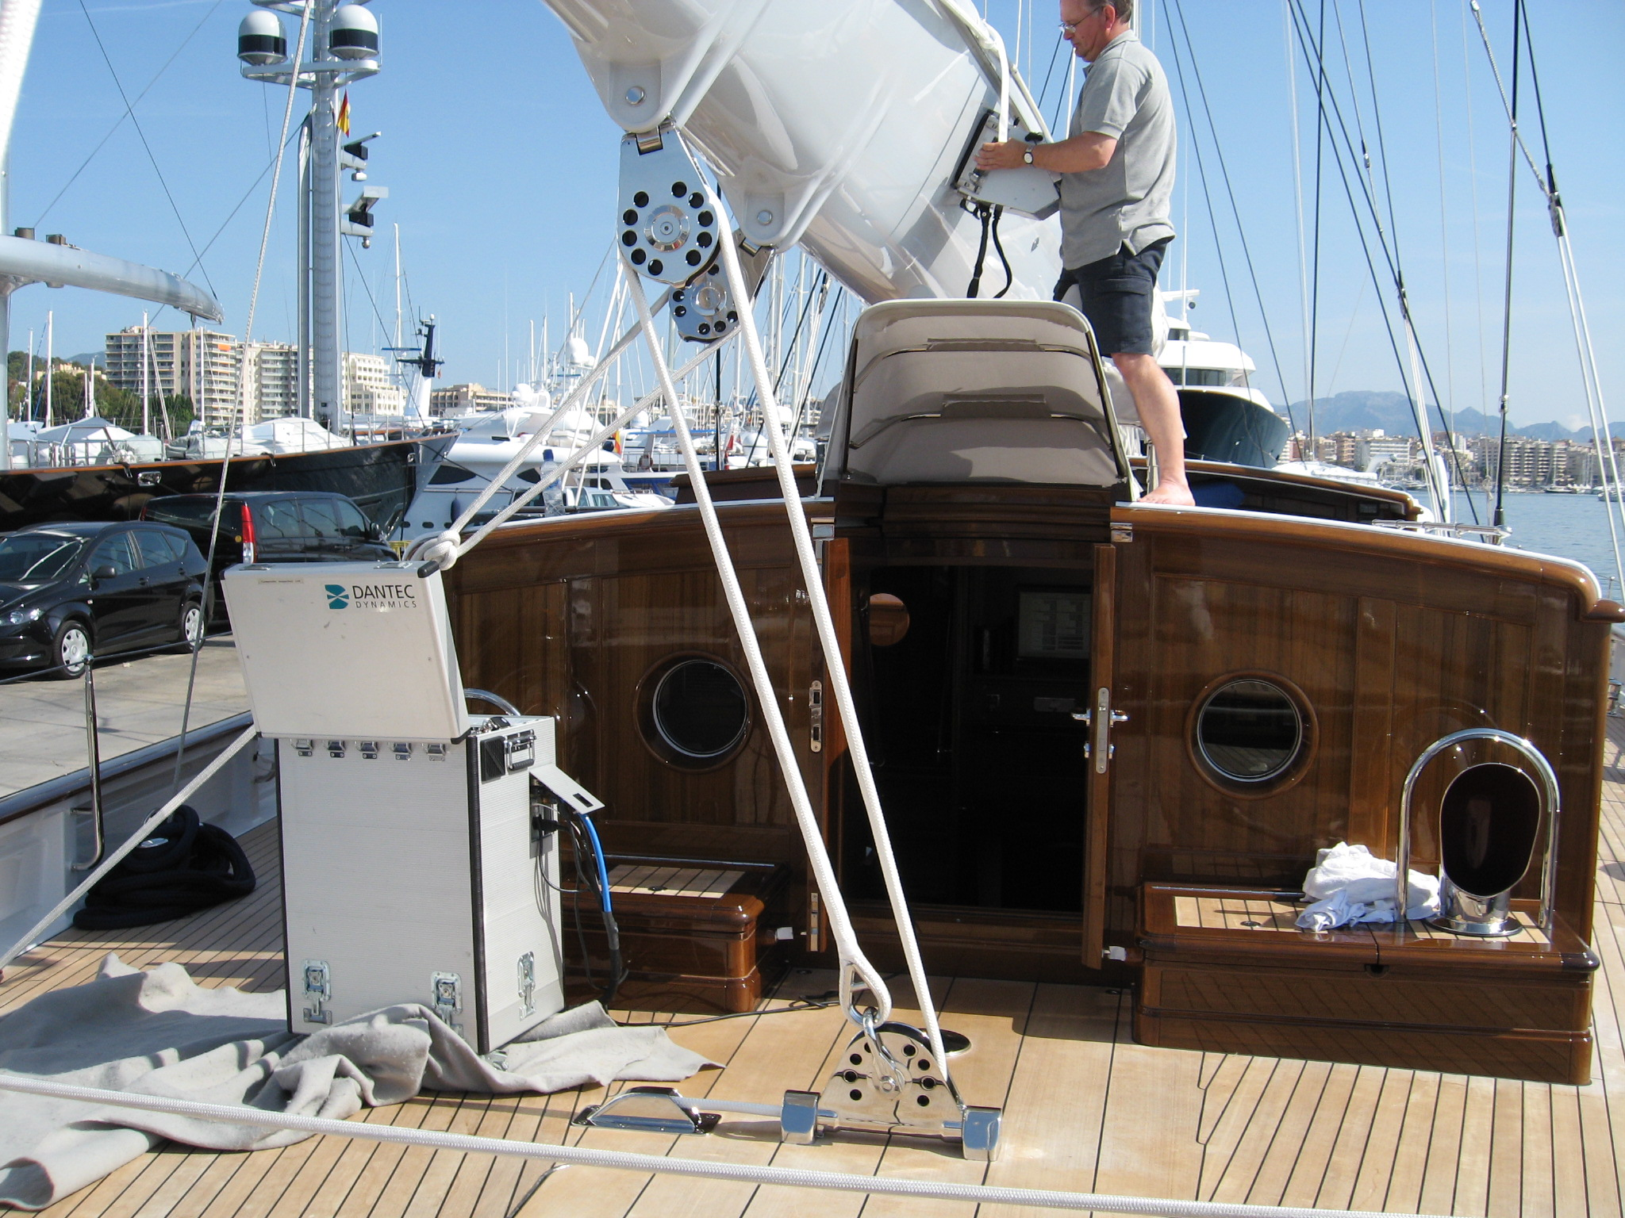

Slide 4
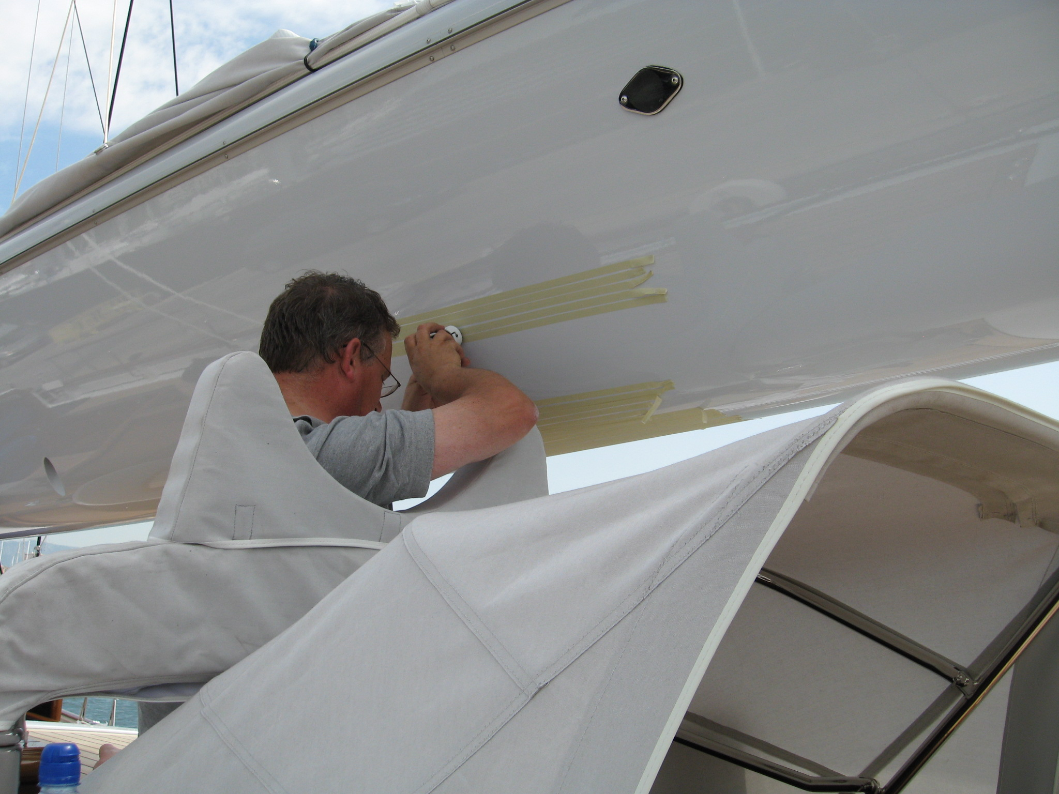

Slide 5
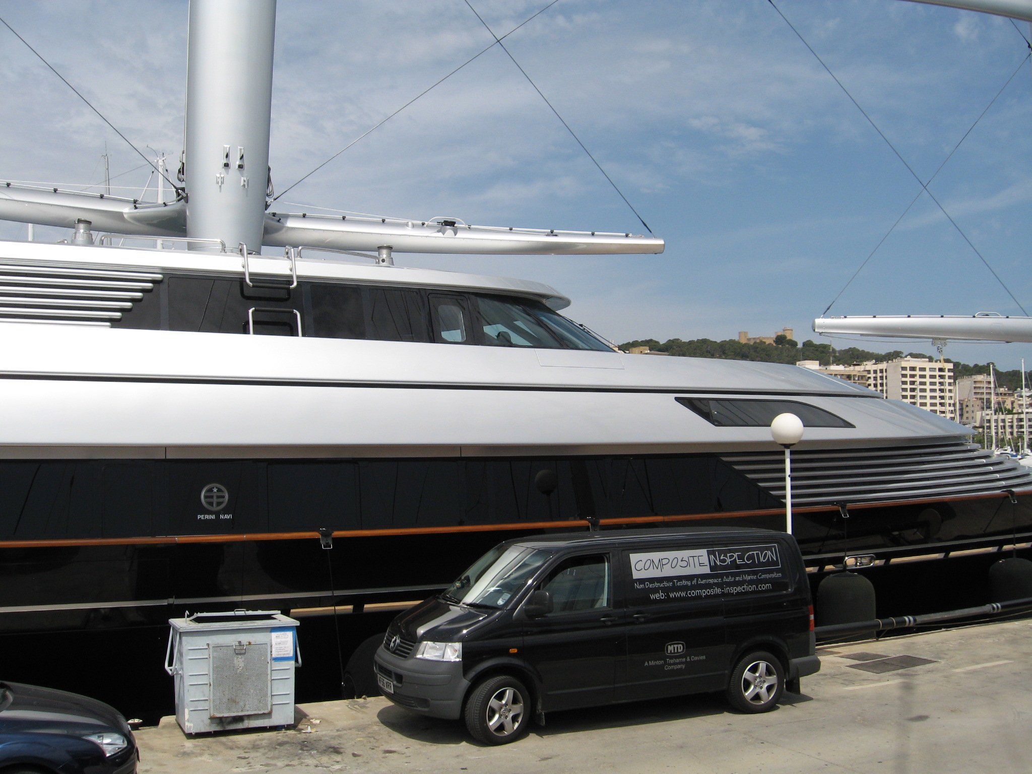

Slide 6
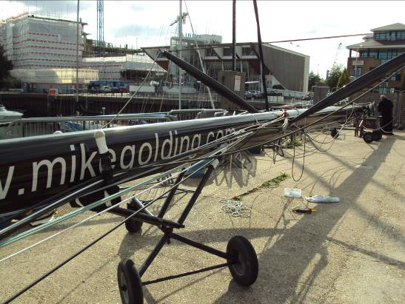

Slide 7
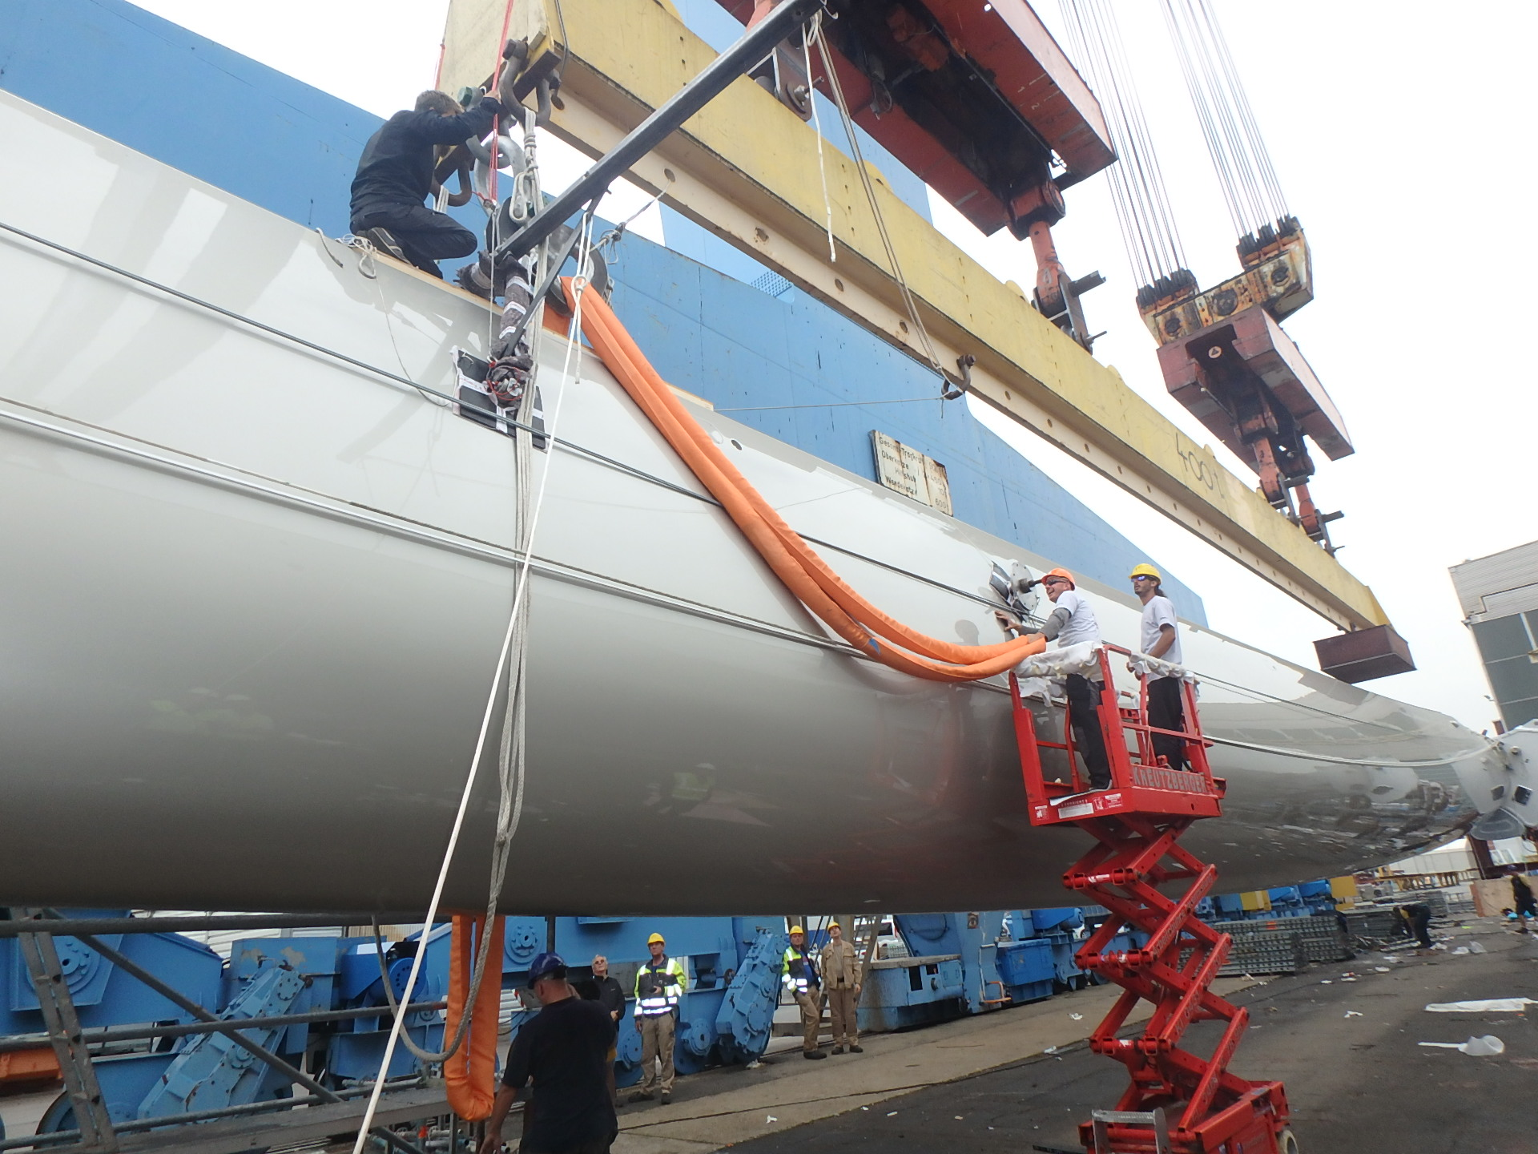

Slide 8
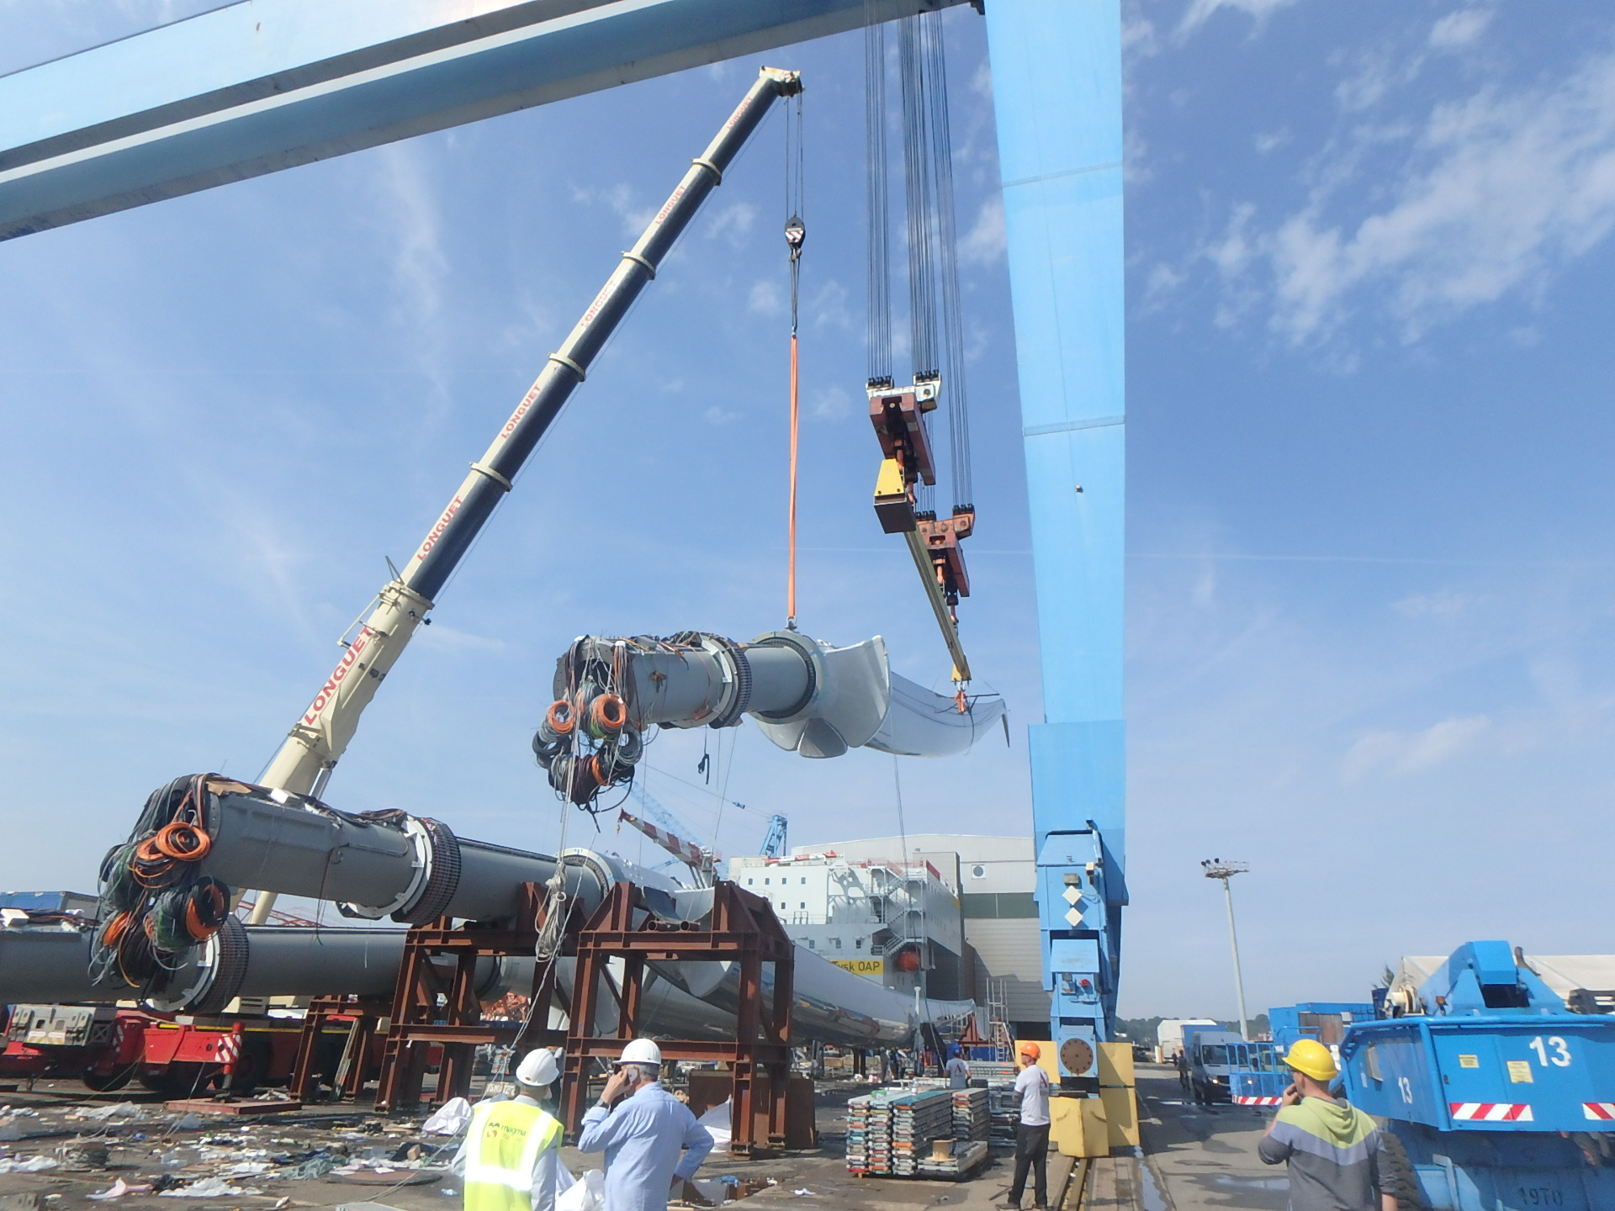

Slide 9
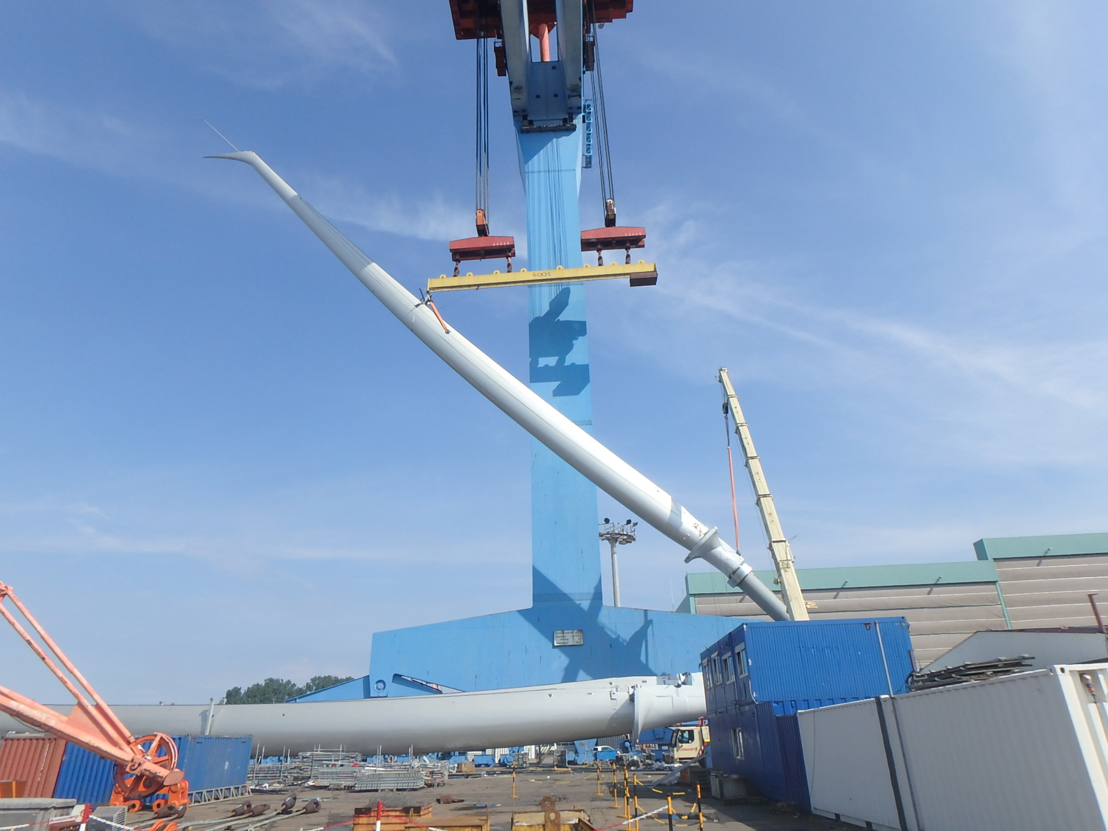

Slide 10
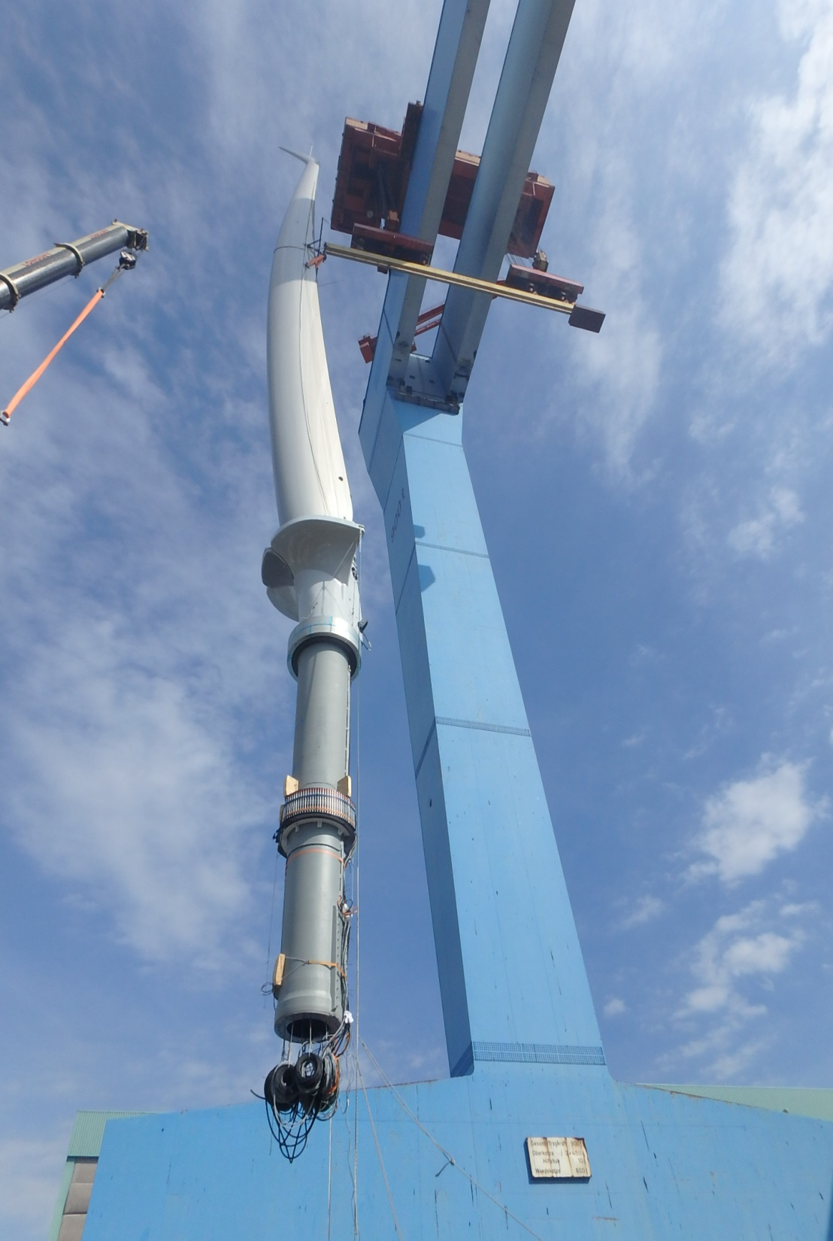
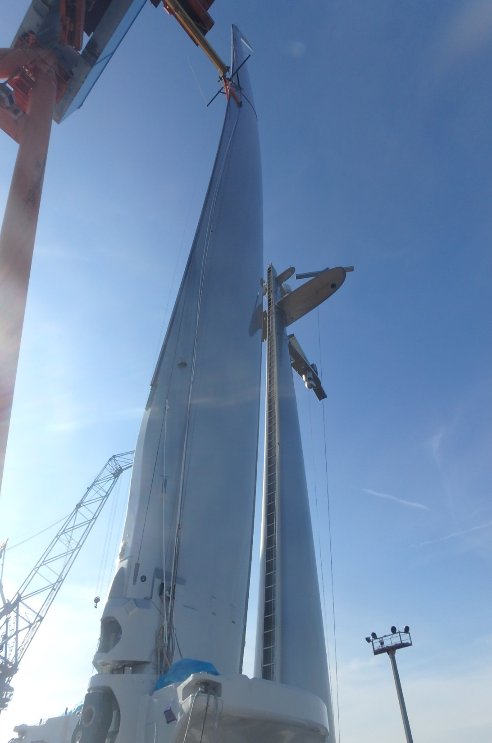

Slide 11
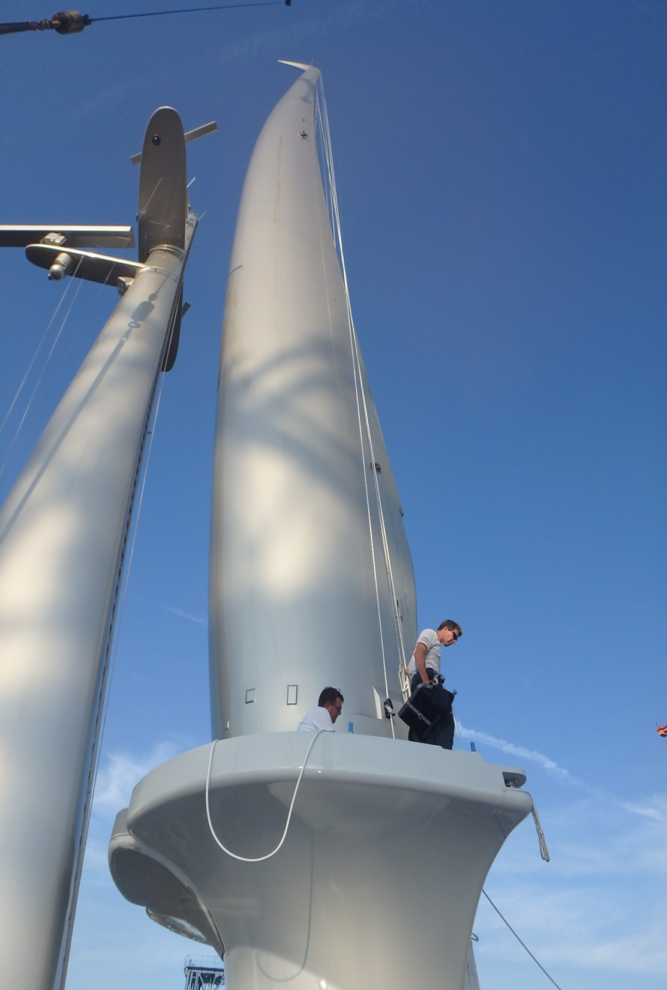
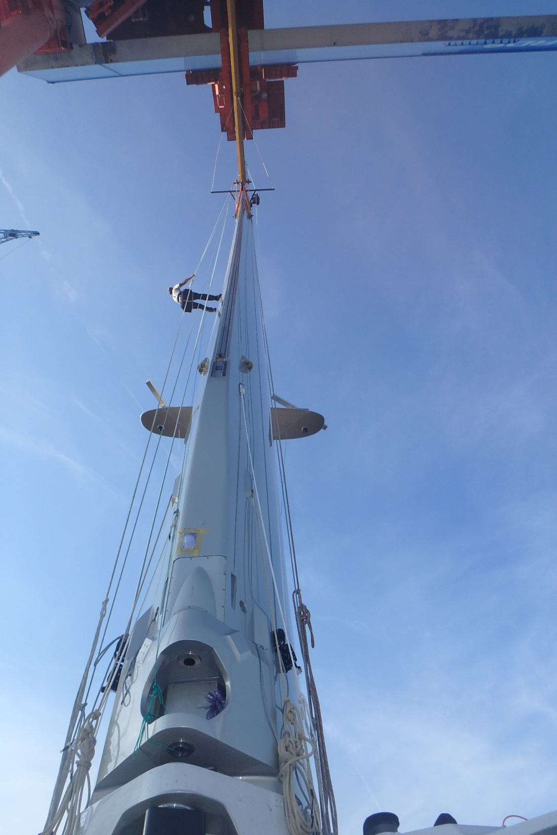

Slide 12
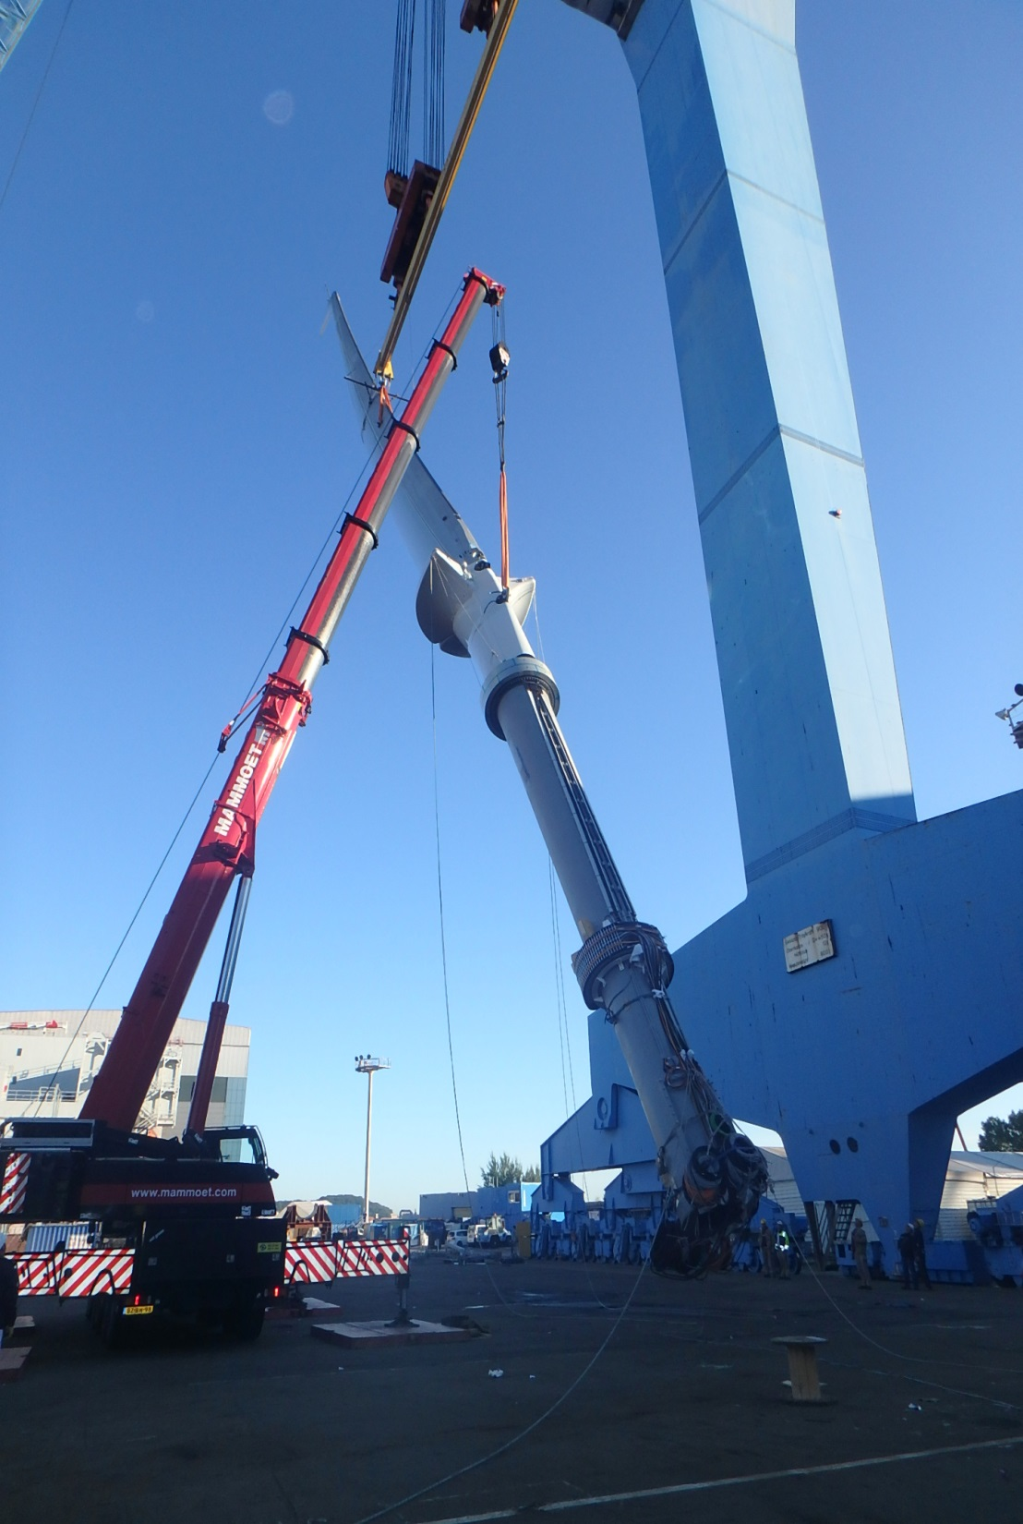
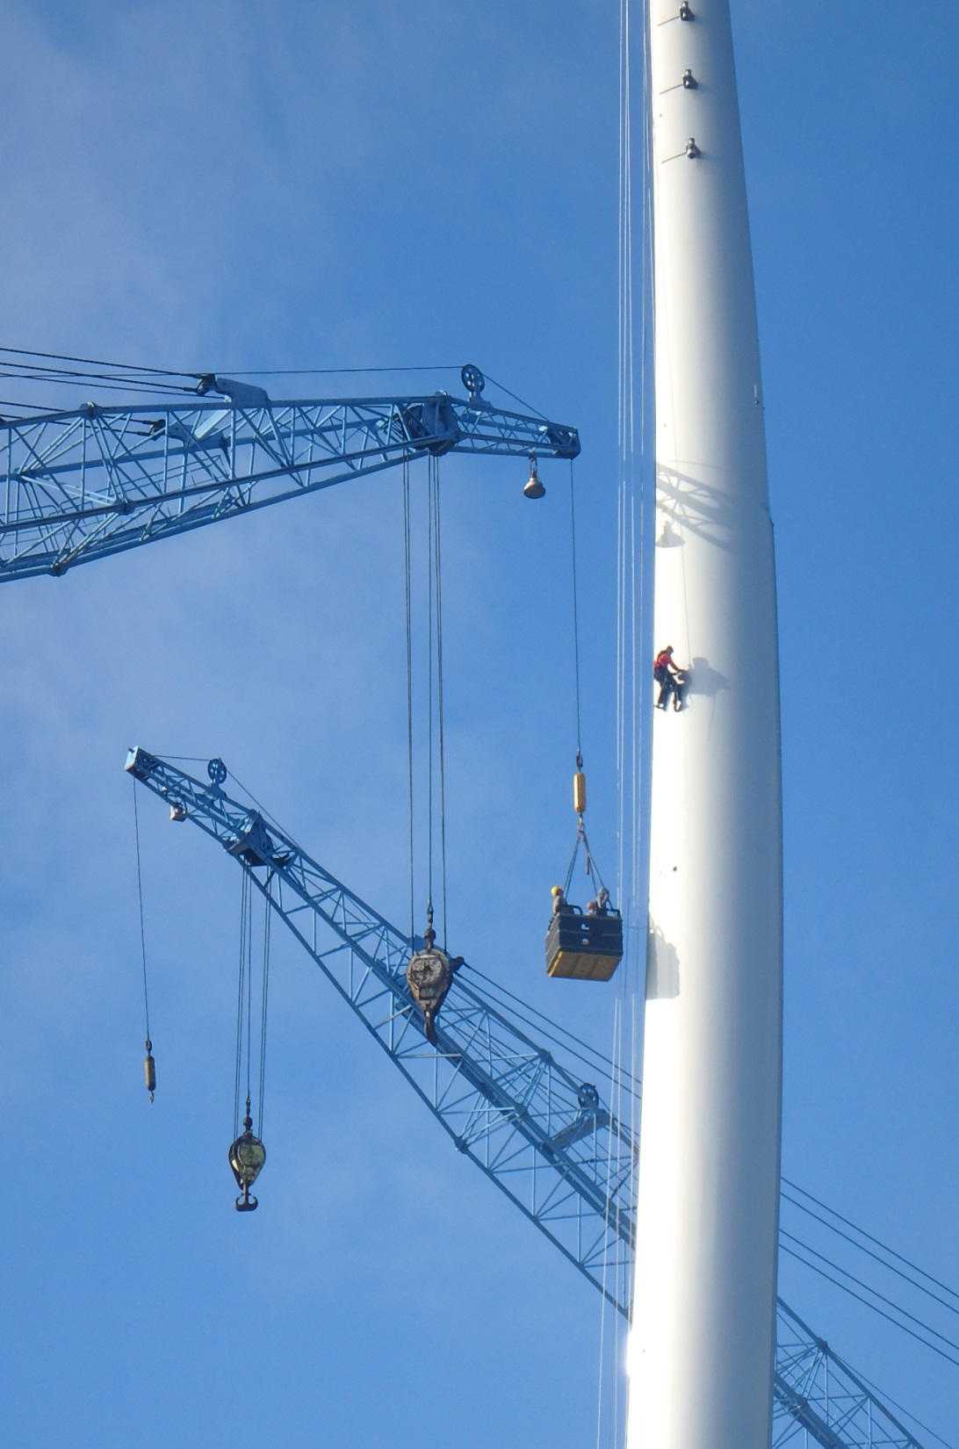

Slide 13
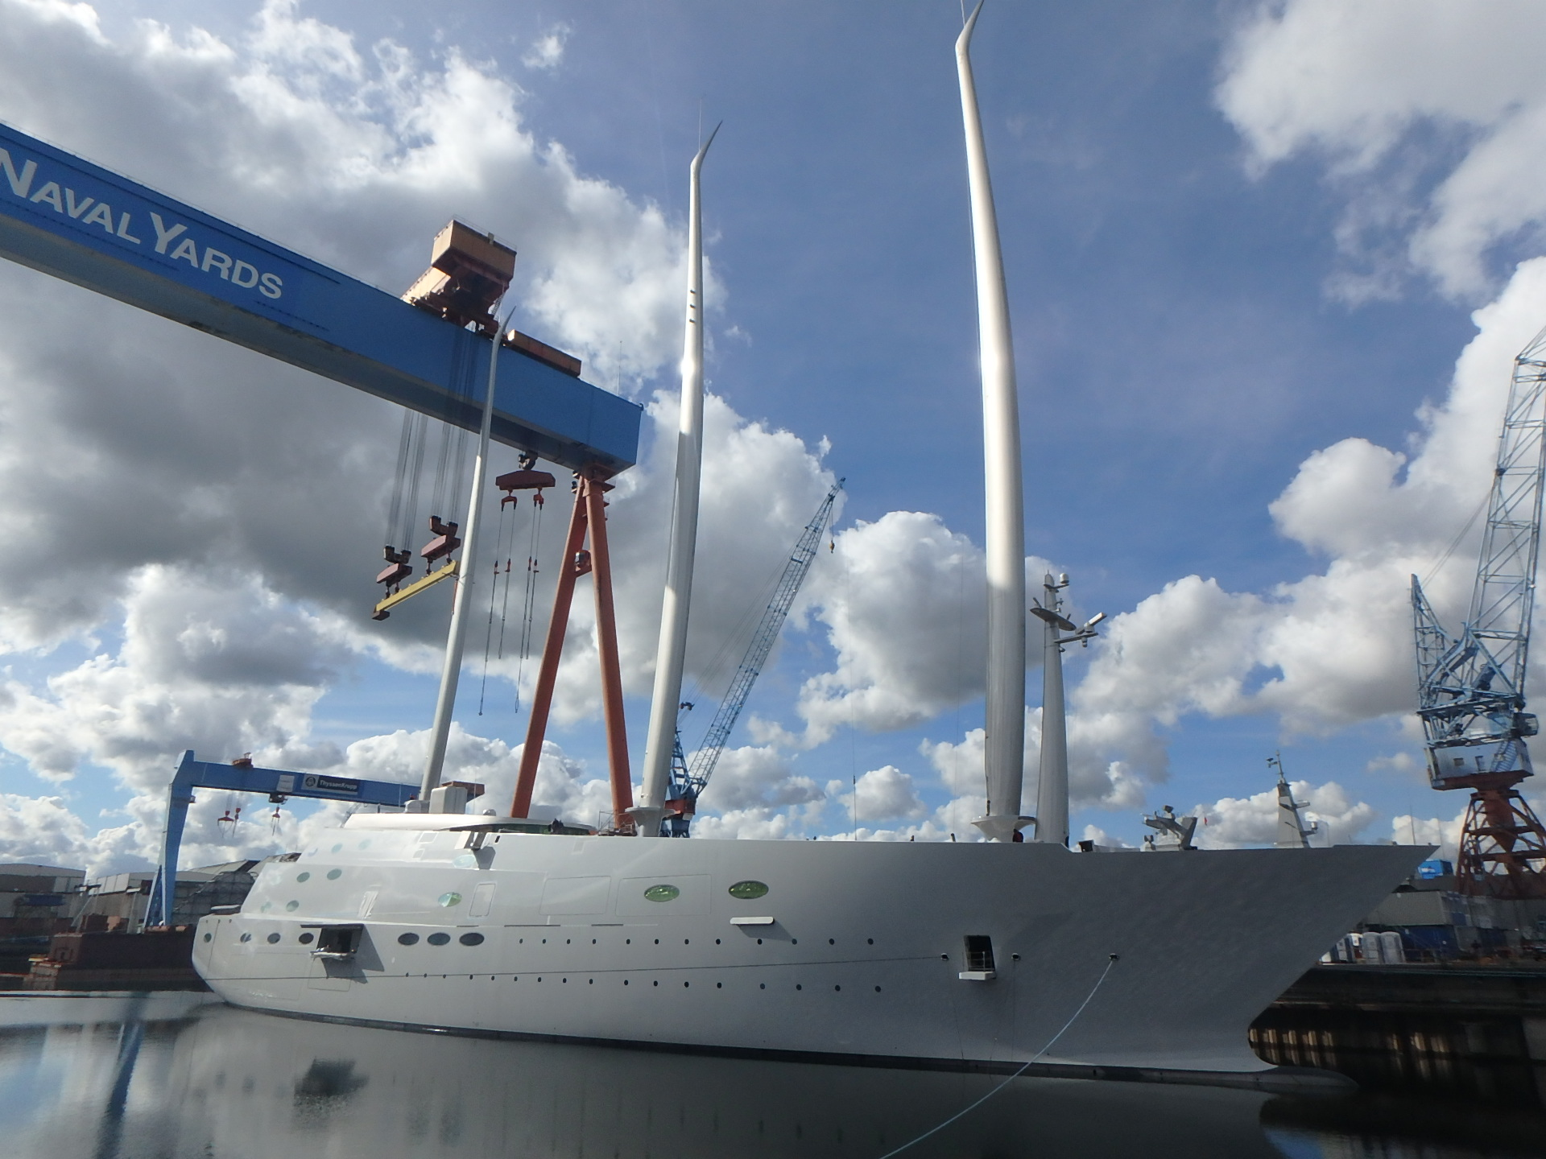

Slide 16
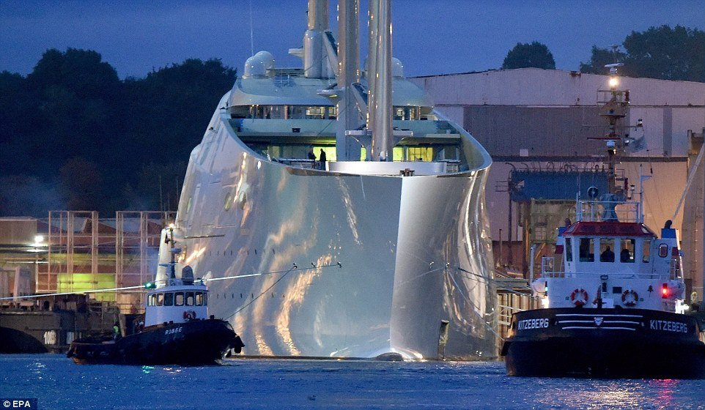

Slide 17
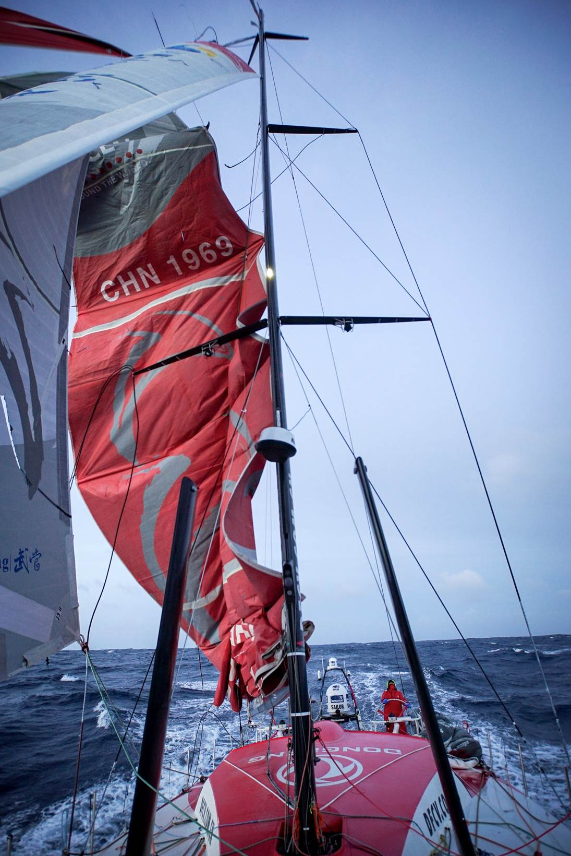
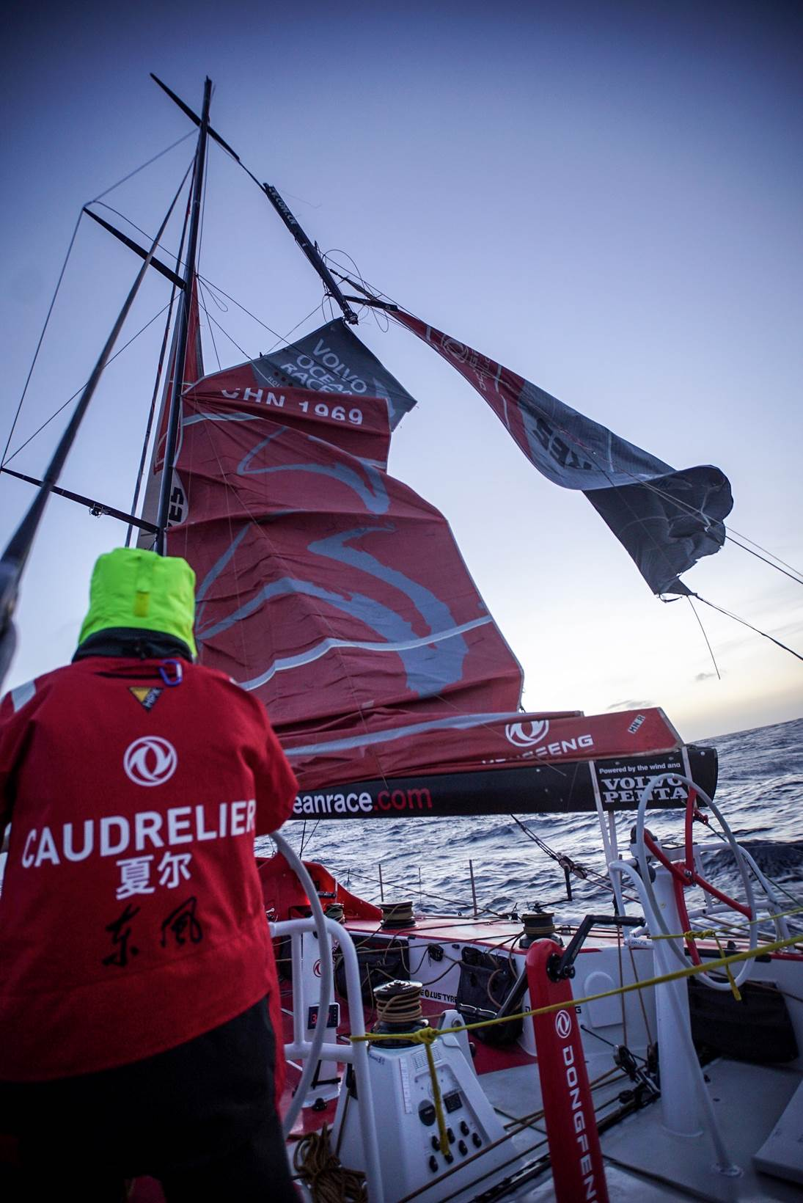

Slide 18
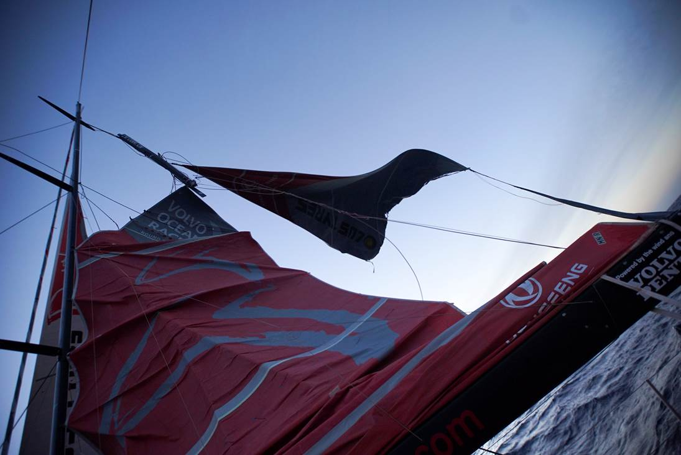

Slide 19
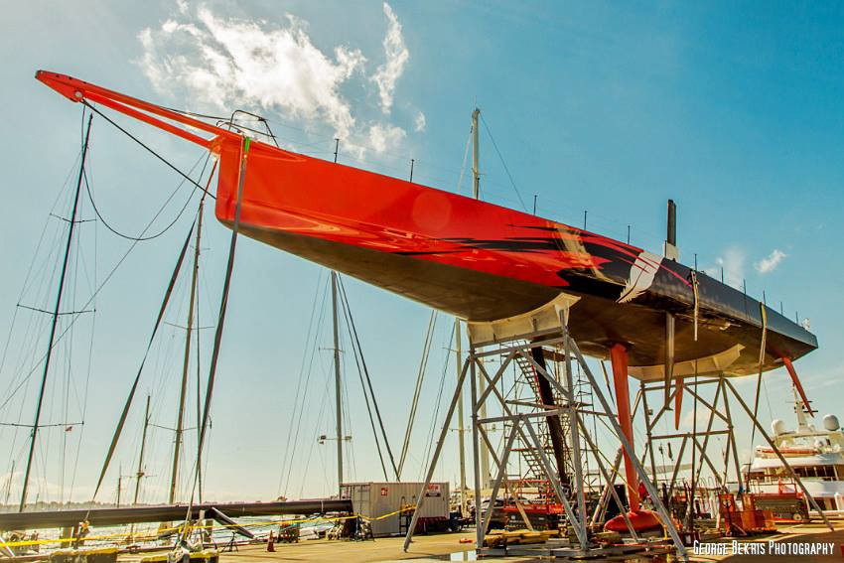

Slide 20
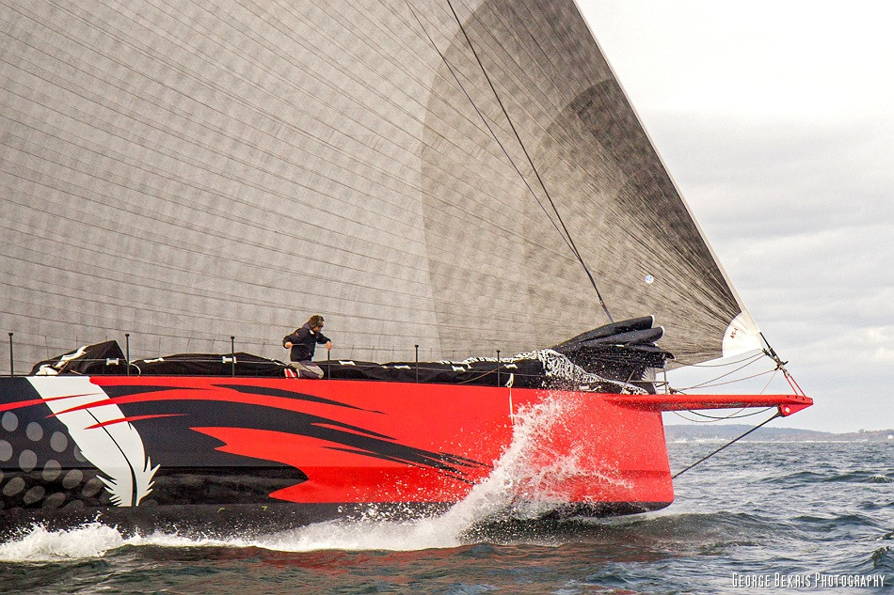

Slide 21
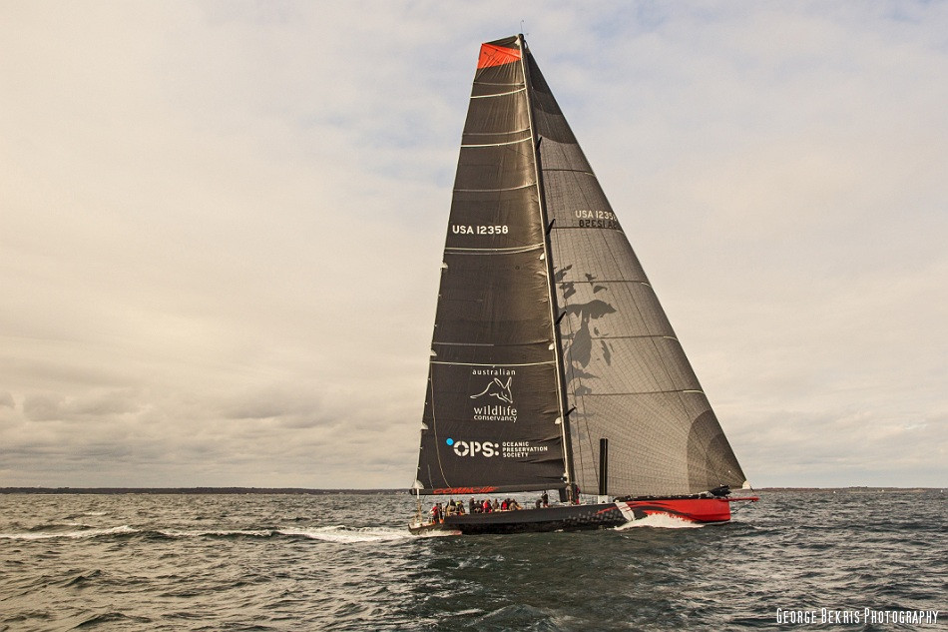

Slide 22
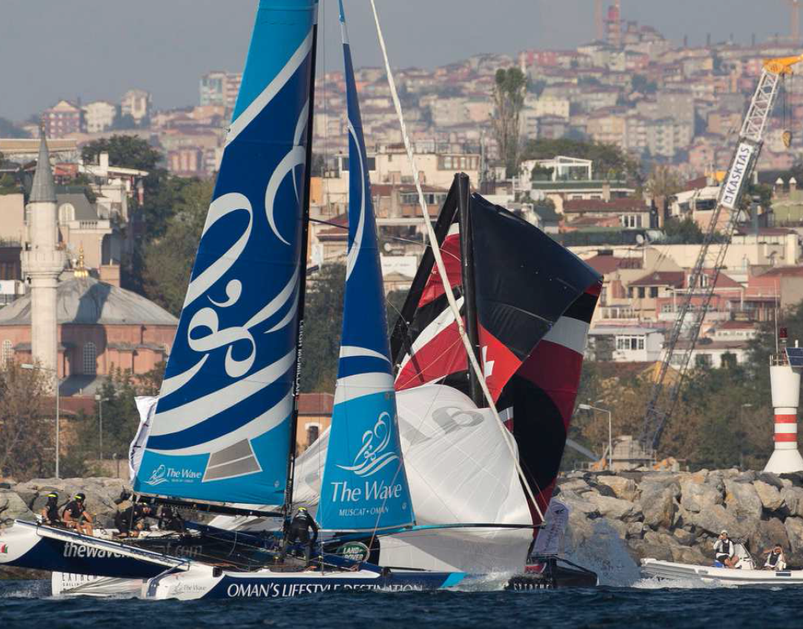

Slide 23
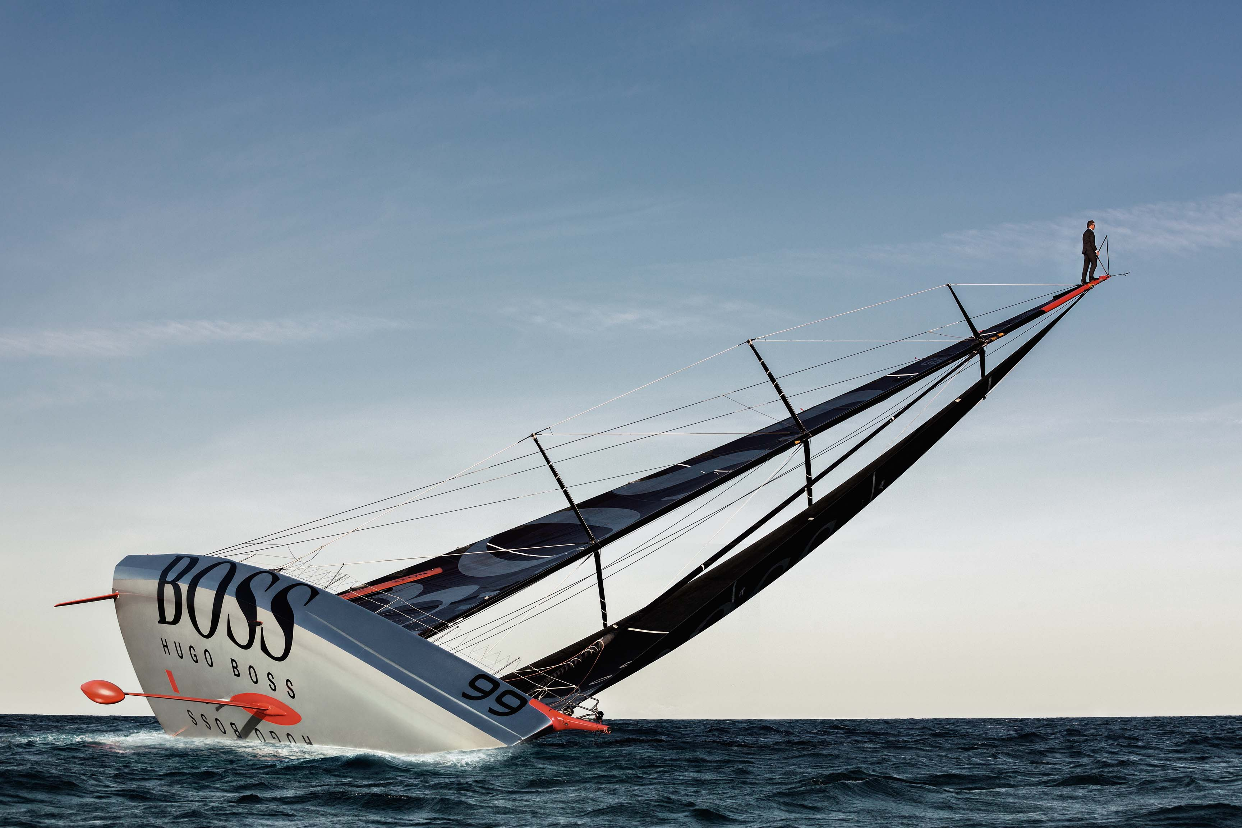

Slide 24
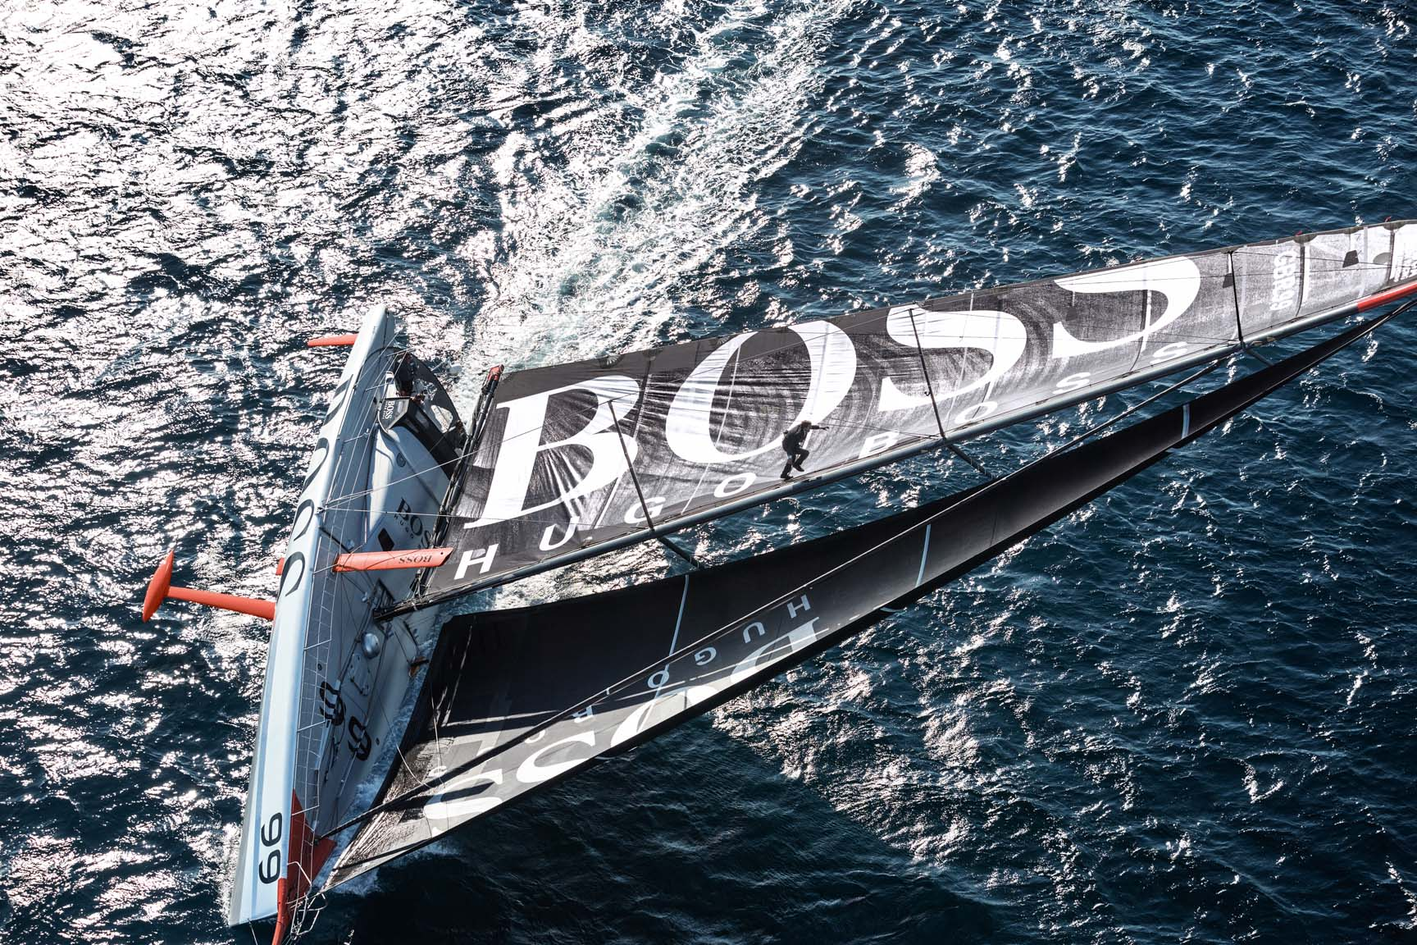

Slide 25
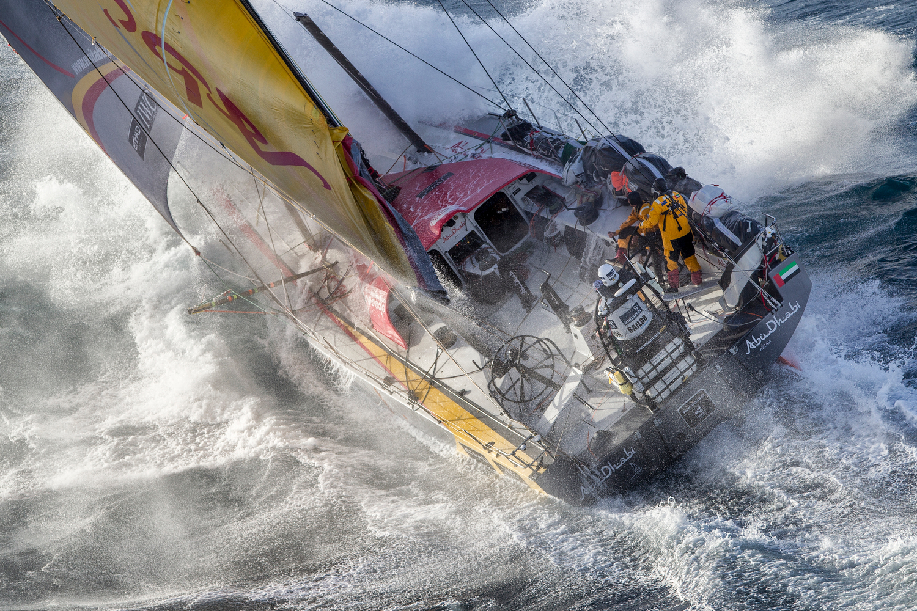

Slide 26
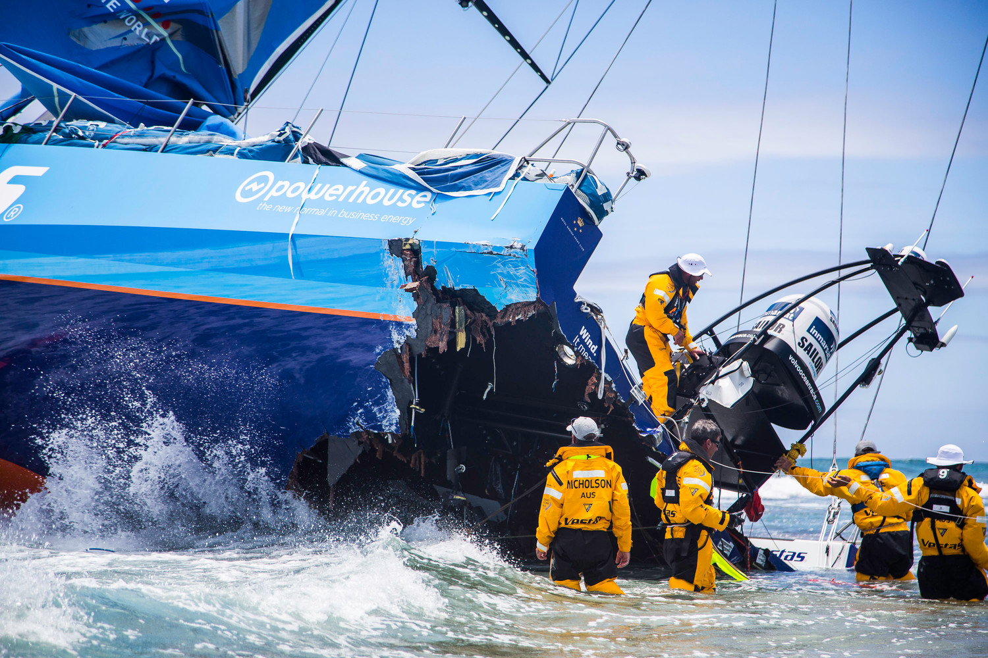

Slide 27
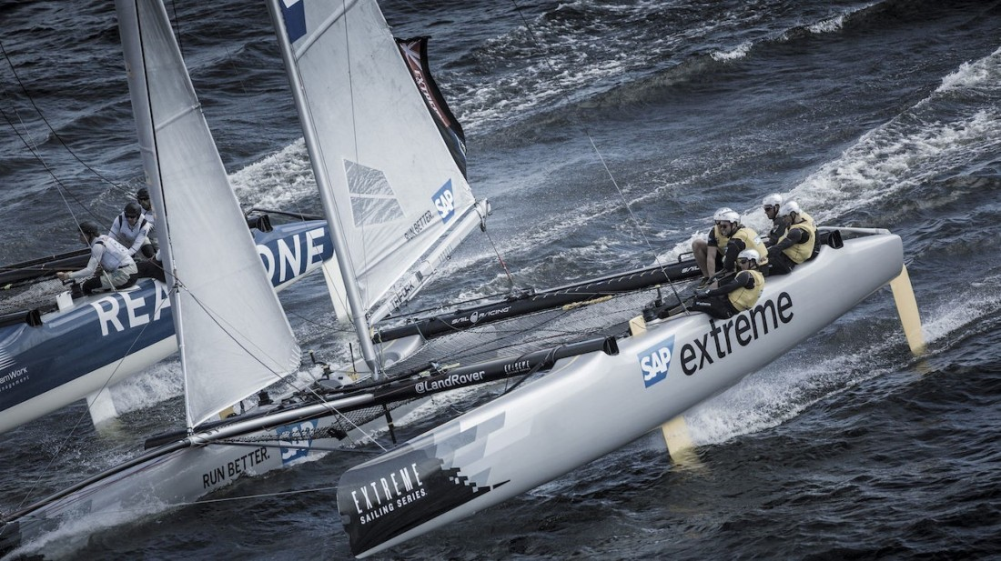

Slide 28
THE CURRENT SITUATION
Several classification societies provide a certification process, this involves re-checking the FEA data but does not include a detailed physical inspection of the structure. This is often mistaken for full classification.
RCD (recreational craft directive) is a safety standard for production boats under 24m which does not include the mast.
No NDT survey standard or industry agreement on acceptable defect size.
Yachting industry is starting to embrace embracing the benefits of NDT in the manufacture of carbon / composite structures.
IMOCA (Open 60) now require an NDT inspection for all new masts but with no standards in terms of scope, quality, breadth, operator qualifications or equipment calibration.

Slide 29
THE CURRENT SITUATION
Yachting has taken a huge leap forwards with foiling and boat speeds on foiling multihulls are reaching impact speeds of 60+ knots.
The quest for lighter structures has led to a number of dramatic failures.
TPT (thin ply technology) is untested in our view.
The cost of new racing yachts is rapidly accelerating and becoming potentially uninsurable without minimum build / classification / survey standards. (A new open 60 circa $6,000,0000)

Slide 30
WHAT DO WE WANT FROM AN NDT INSPECTION?
Independent review of the structure
Quality Control
Comfort
Ability to create a Record Log that will track anomalies through the life of the structure.
Racing yachts are starting to be sold with a service/NDT record/history

Slide 31
WHY DO WE WANT AN NDT SURVEY STANDARD?
Classification societies will not take the task on (too small, too costly, not in their interests)
Too many unqualified surveyors offering cheap and ineffective NDT services
NDT seen as an unnecessary evil imposed by Insurers (this view is starting to soften)
Owners attracted to cheapest price/lowest standard

Slide 32
OUR EXPERIENCE
We have insured in excess of 1,100 high risk racing yachts since 2007
140 claims within that period = £14,700,000 but reduces to £10,000,000 excluding Vestas claim
Premium received £15,300,000 (Risks still live)
Claims frequency is double that of a normal yacht book
27 claims identified as due to carbon failure
Of which 7 had NDT inspections

Slide 33
OUR EXPERIENCE
69 risks had NDT Inspections – primarily VOR 65, Open 60
62 (90%) have had no claims
We introduced NDT Inspections for Class 40 yachts in 2016 following a number of claims
Approximately one third of all class 40 claims are mast failures
In 2017 we introduced a Class 40 NDT schedule and we are now utilising this framework on other fleets.

Slide 34
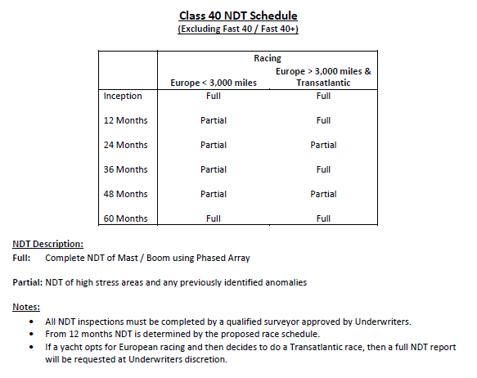
CLASS 40 NDT SCHEDULE

Slide 35
CONCLUSION
The Industry is starting to embrace the benefits of NDT.
The introduction of an ISO Survey Standard will in our view be a benchmark in raising the professionalism of the industry.
Education, Education, Education!

Slide 36
A CHALLENGE TO THE NDT INDUSTRY
Carbon Rigging is also a major issue for insurers and there is currently, to our knowledge, no way of testing the rigging following an incident.
We have had several incidents where we have had to write off carbon rigging where it only seems to have suffered superficial damage following a lightning strike.
Lightning incidents have reduced but we have seen no developments in testing !
Thank you

